Slide 1
XML Parser Project
By: Dhanusha Piumal Siriwardane

Slide 2
Table of Contents
Assignment Question
Class Diagram
Explanation about Development

Slide 3
Assignment Question
As your first assignment please implement a XML parser which can be used in a program
Read an XML file structure
Access Elements by name or ID
Access Attributes of an Element
Access Parent Element of an Element
Access Child Element of an Element

Slide 4
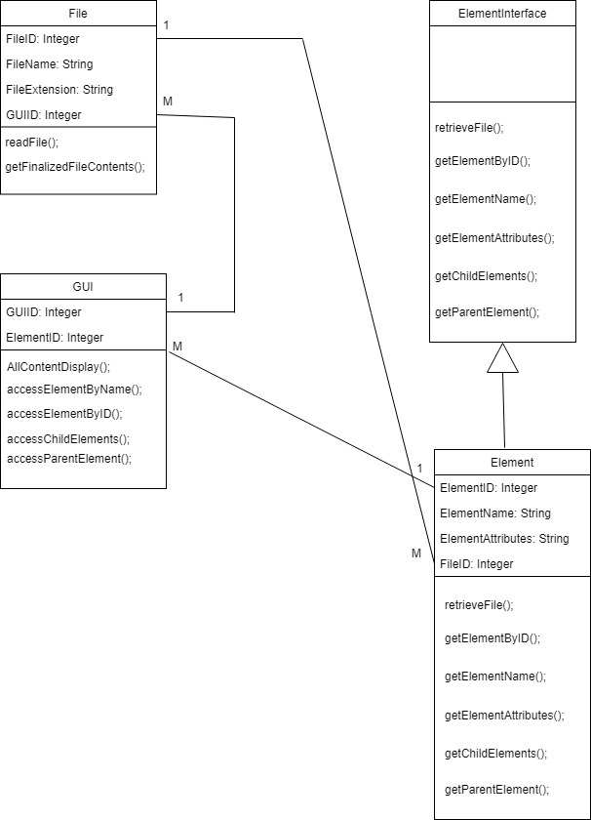
Class Diagram

Slide 5
Explanation about Developed System

Slide 6
Any Questions ???

Slide 7
Thank You!

